Slide 1
RNA-seq Introduction
Good practices / Experimental design

Slide 2
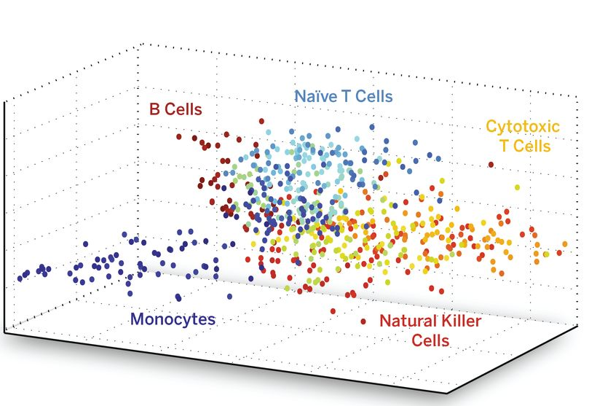
DNA is the same in all cells RNAs are different in all cells

Slide 3
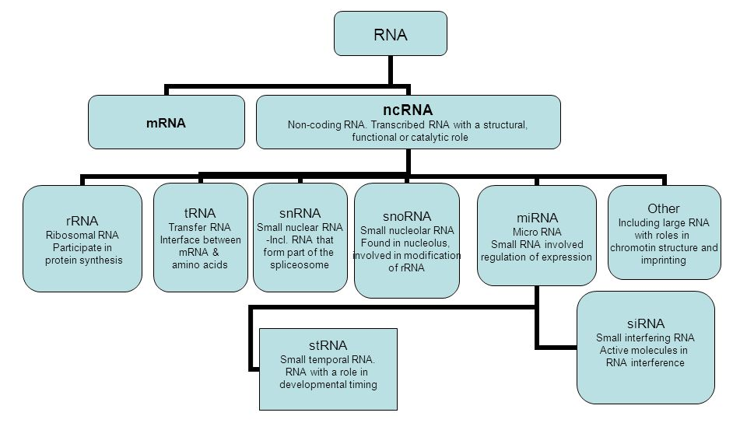
There is a wide variety of different functional RNAs

Slide 4
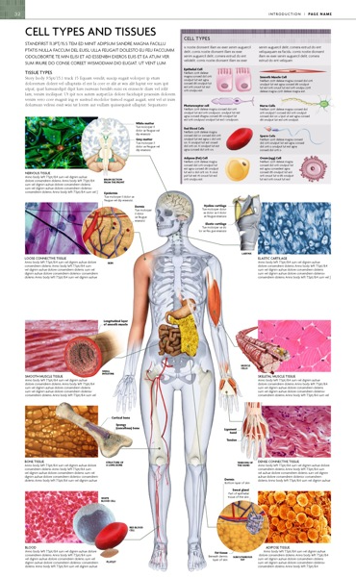
RNA varies between samples
-Tissues
Cell types
Cell states
-Individuals
-Cells

Slide 5
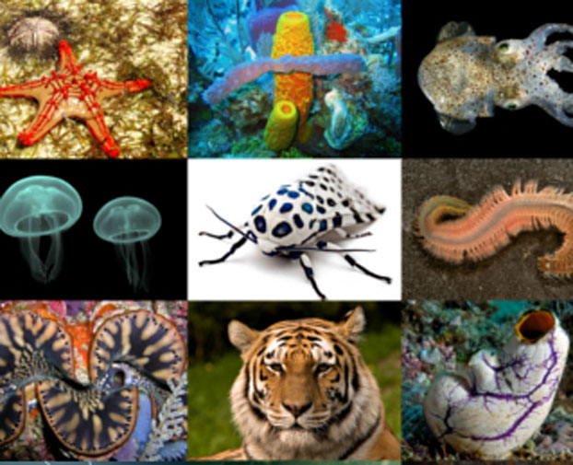
RNA gives information on which genes are expressed
How DNA get transcribed to RNA (and sometimes then translated to proteins) varies between e. g.
-Tissues
Cell types
Cell states
-Individuals

Slide 6
One gene many different mRNAs

Slide 7
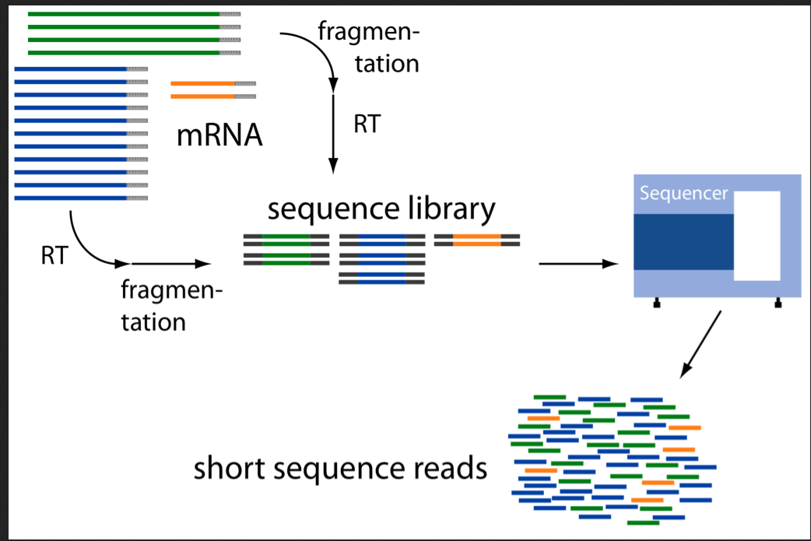
How are RNA-seq data generated?
Sampling process

Slide 8
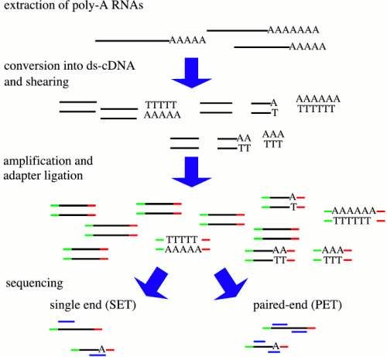
Depending on the different steps you will get different results
RNA->
AAAAAAAA
PolyA (mRNA)
RiboMinus (- rRNA)
Size <50 nt (miRNA )
…..
enrichments ->
Size of fragment
Strand specific
5’ end specific
3’ end specific
…..
library ->
reads ->
Single end (1 read per fragment)
Paired end (2 reads per fragment)

Slide 9
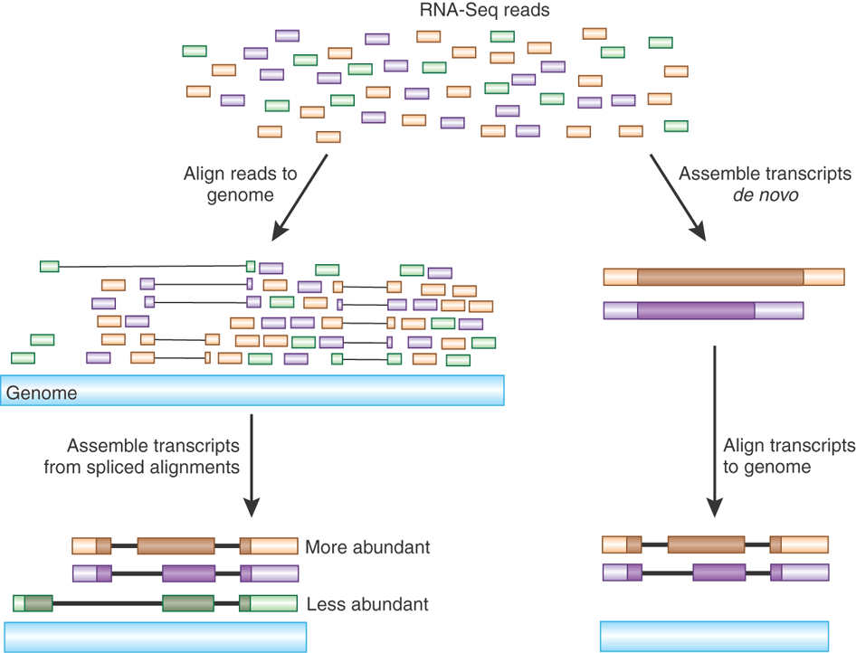

Slide 10
Different kind of RNAs have different expression values

Slide 11
What could go wrong?
RNA quality:
Degradation
Contaminations (pathogens or other sources)
GC-bias
Nuclear vs organellar reads
Library prep:
Failed reactions
RNA / Adapter ratios – primer dimers
Clonal duplicates
Chimeric reads
Contaminations
Sequencing:
Base calling errors
Uncalled bases
Low quality bases (3’ end)
Contaminations
Sequence complexity

Slide 12
What could go wrong?
RNA quality:
Degradation
Contaminations (pathogens or other sources)
GC-bias
Nuclear vs organelle reads
Library prep:
Failed reactions
RNA / Adapter ratios – primer dimers
Clonal duplicates
Chimeric reads
Contaminations
Sequencing:
Base calling errors
Uncalled bases
Low quality bases (3’ end)
Contaminations
Sequence complexity

Slide 13
What could go wrong?
RNA quality:
Degradation
Contaminations (pathogens or other sources)
GC-bias
Nuclear vs organelle reads
Library prep:
Failed reactions
RNA / Adapter ratios – primer dimers
Clonal duplicates
Contaminations
Sequencing:

Slide 14
What could go wrong?
RNA quality:
Degradation
Contaminations (pathogens or other sources)
GC-bias
Nuclear vs organelle reads
Library prep:
Failed reactions
RNA / Adapter ratios – primer dimers
Clonal duplicates
Contaminations
Sequencing:
Base calling errors
Uncalled bases
Low quality bases (3’ end)
Contaminations
Sequence complexity

Slide 15
From samples to reads - may not be what you think they are
Mixing samples
Experiments go wrong
How do we understand what went wrong?

Slide 16
From samples to reads - may not be what you think they are
Mixing samples
Experiments go wrong
How do we understand what went wrong?
BIOINFORMATICS!

Slide 17
RNA-seq analysis workflow
reads.fastq.gz
STAR
mappedReads.bam
Reads
Mapping
Mapped reads
Gene annotation:
ref.bed / ref.gtf
Reference
genome.fa
Gene expression

Slide 18
Read QC
- FastQC
Mapping statistics
Mapping QC
- RseQC
reads.fastq.gz
STAR
mappedReads.bam
Reads
Mapping
Mapped reads
Gene annotation:
ref.bed / ref.gtf
Reference
genome.fa
Gene expression
Outlier detection, sample swaps

Slide 19
Sources of variation
Biological variation
Patient to patient variation
Sex
Time points of samples taken
Etc…..
Technical variation
At each step of RNA extraction and library preparation

Slide 20
Spike-in control RNA
Addition of external RNA molecules into the samples before library prep
Will give estimate of technical variation:
Sensitivity / detection
Accuracy
Specific biases
Also used to estimate amount of RNA in the samples
Most commonly ERCC - pool of 48 or 96 synthetic mRNAs with various lengths and GC content, at 17 different concentrations
Allows for cross comparison of datasets

Slide 21
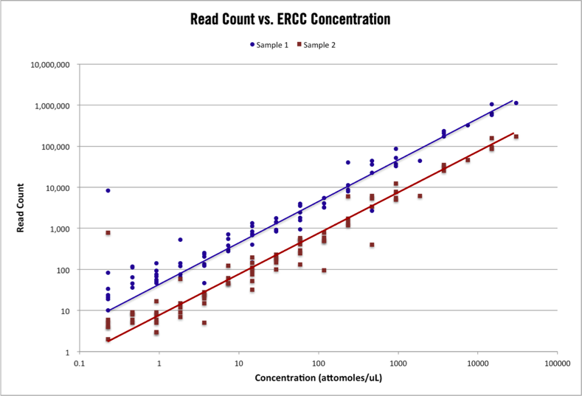
(https://cofactorgenomics.com)

Slide 22
Technical noise / Biological variation
Squared coefficient of variation: CV²
CV = std / mean

Slide 23
Replicates, replicates, replicates
Technical replicates
Biological replicates
If you have enough material, always do extra replicates in case you want to remove low quality samples.

Slide 24
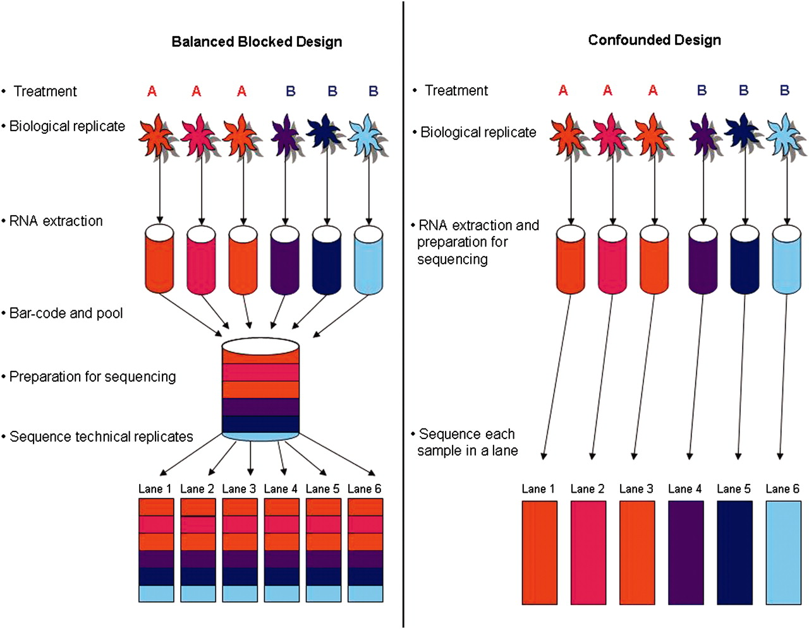
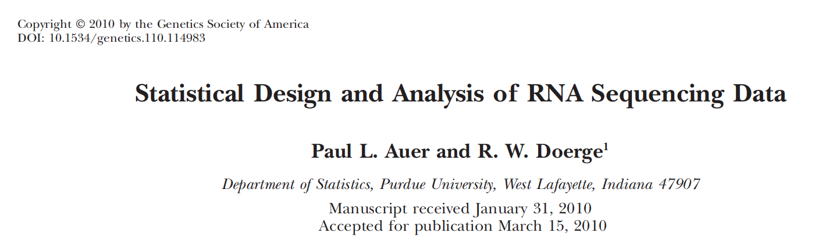
Experimental Design

Slide 25
RNA seq course

Slide 26
The RNA seq course
Mapping reads programs
Transcriptome reconstruction using reference
Transcriptome reconstruction without reference
QC analysis
Differential expression analysis
Gene set analysis

Slide 27
Take home message
Always think what kind of information you want to achieve with your experiment
Design your experiment to differentiate between technical and biological variation
If your experiment was design correctly the analysis will be easier and quicker!

